Slide 1
TDCV Project 1:Keypoint based object detection, pose estimation and refinement
Task 2: Pose Estimation with PnP and RANSAC
Mai Bui, Ivan Shugurov and Roman Kaskman

Slide 2

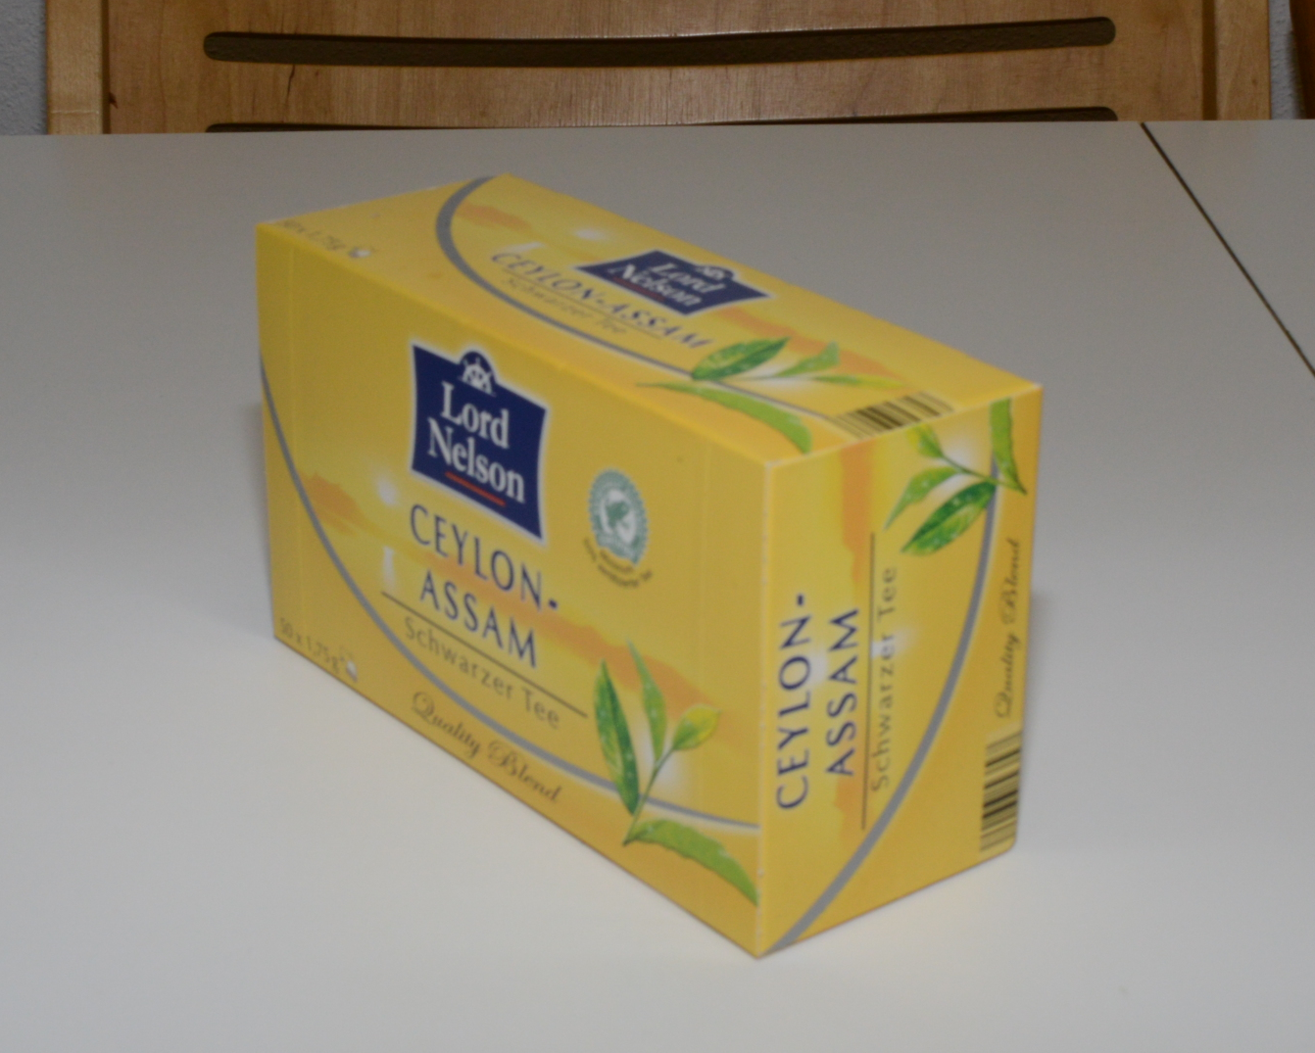
Where we stand after Task 1

Slide 3
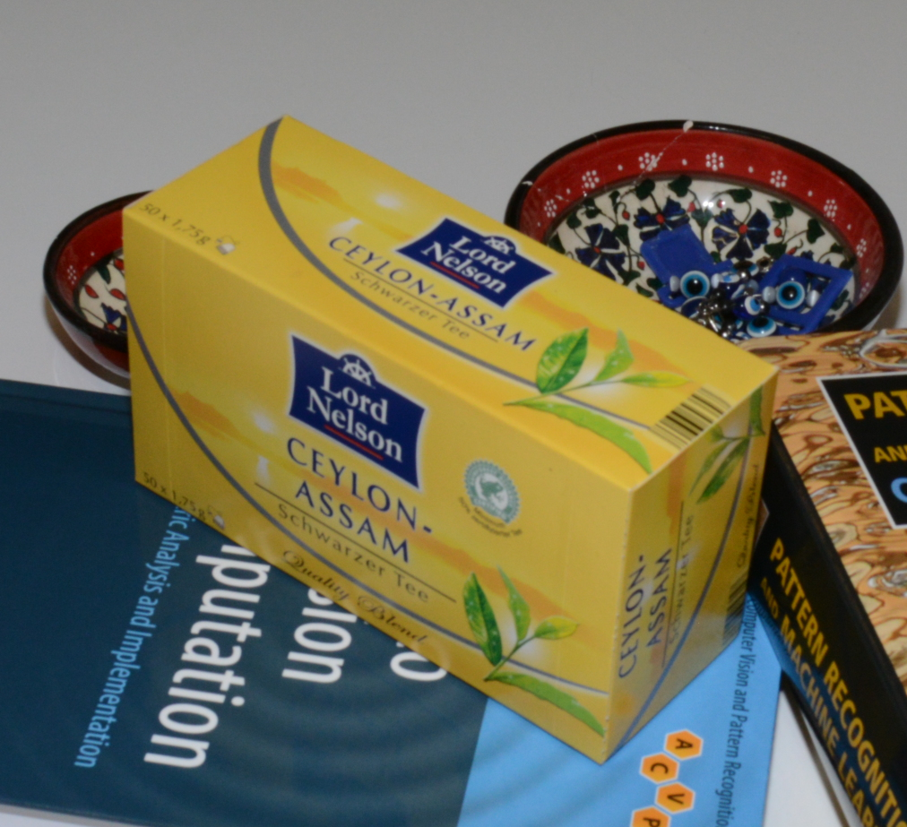
What now? Compute SIFT keypoints, match them to precomputed
Training stage
Test stage

Slide 4
What now? 2D-3D correpondences
Training stage
Test stage

Slide 5
What about the outliers?
Training stage
Test stage

Slide 6
RANSAC!
Training stage
Test stage

Slide 7
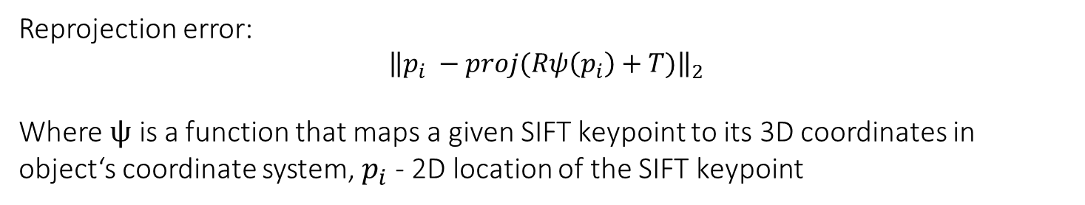
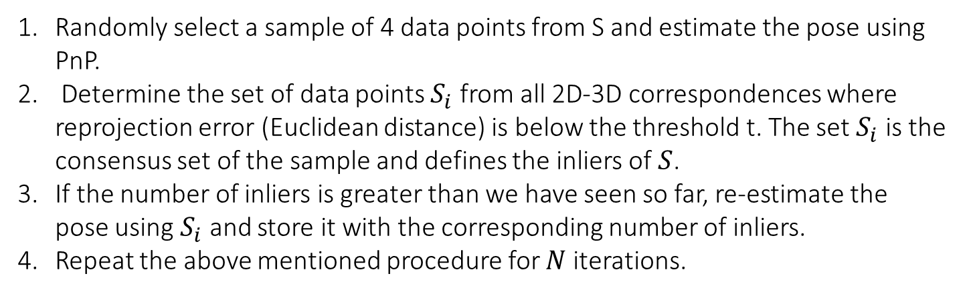
RANSAC
Randomly select a sample of 4 data points from S and estimate the pose using PnP.
Determine the set of data points $S_{i}$ from all 2D-3D correspondences where reprojection error (Euclidean distance) is below the threshold t. The set $S_{i}$ is the consensus set of the sample and defines the inliers of $S$.
If the number of inliers is greater than we have seen so far, re-estimate the pose using $S_{i}$ and store it with the corresponding number of inliers.
Repeat the above mentioned procedure for $N$ iterations.
Reprojection error:
$${\left\|p_{i} −proj(Rψ\left(p_{i}\right)+T)\right\|}_{2}$$
Where $ψ$ is a function that maps a given SIFT keypoint to its 3D coordinates in object‘s coordinate system, $p_{i}$ - 2D location of the SIFT keypoint

Slide 8
Expected output
Visualization of predicted poses as projection of 3D bounding box

